Slide 1
ABA Advocacy
Lew Myers
Director of Policy, Research & Impact

Slide 2
Overview
ABA Strategic Plan
Industry Observations
Advocacy Toolbox
Policy Agenda
Policy Landscape
ABA Foundation

Slide 3
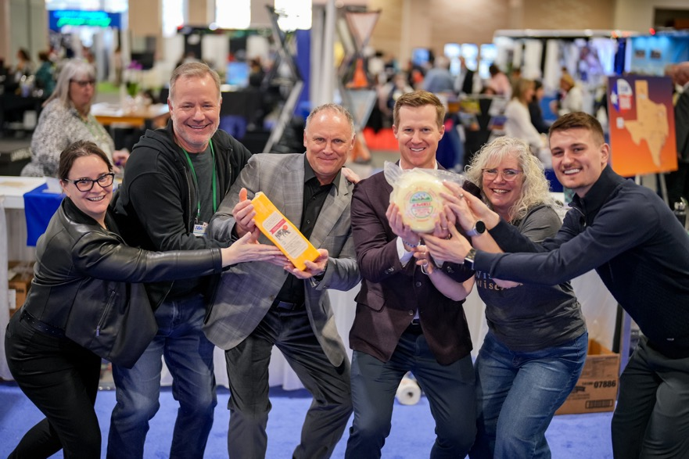
New leadership, focused strategy
The bus is at the heart of everything we do
Reinvest in ABA Value Proposition & Grow Industry for All Sectors
Attract Partners & Facilitate Commerce
Recruit & Represent Operators
2026!
Staffing
ABA Flywheel
New ABA President and CEO Fred Ferguson
Notes:
New CEO; here’s Fred @ Wisconsin booth with John Meier
ABA Strategic Plan in one image
When we have bus operators, we naturally attract business, which makes Associations stronger
We need operators to join us, when you join, we have more partners which allows us to all make more money

Slide 4
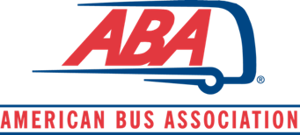
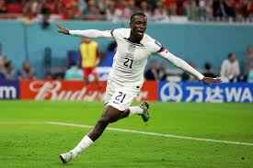
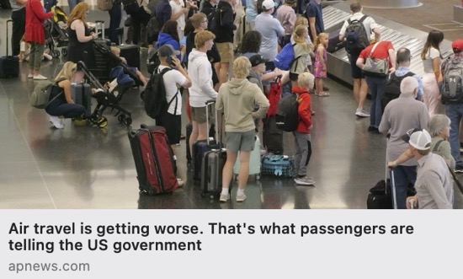
Industry Opportunities
Collaboration
Trade Wars
Major Events
Travel Stinks
Notes:
Before we get started; this is an observation of the industry
Coming from Capitol Hill, I’ve learned to maximize impact, you have to have collaboration and in this climate of uncertainty, we’re seeing more collab than ever
Trade Wars are not good; no one benefits from that tension
World Cup, Olympics
Perception of travel to the US is declining, which effects all of us
Inner travel, train travel- this is an opportunity for buses to be a viable alternative

Slide 5
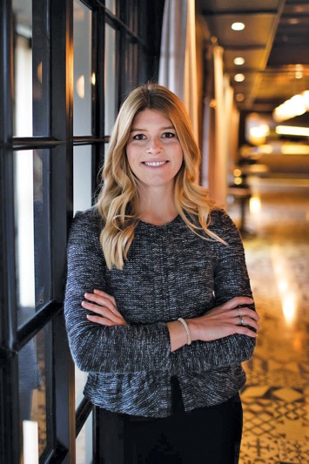
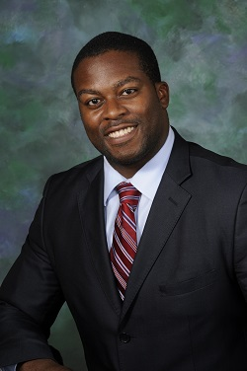
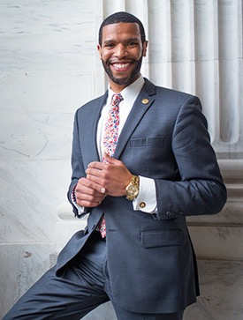
In-house Public Affairs, Government Relations, Research and Regulatory Affairs
Callie Hoyt, SVP Public Affairs and Government Relations
Brandon Buchanan, Director Regulatory Affairs
Lew Myers, Director Research, Policy and Impact
Notes:
Main purpose of my presentation is government affairs

Slide 6
BUSES MOVE AMERICA
ABA Policy Agenda
Promote Effective and Sensible Safety Practices and Regulations
Protect and Grow the Motorcoach and Group Travel Sector
Improve and Expand Access to Bus Service
Drive Expansions of Travel and Tourism
Advance Innovation and Infrastructure Modernization
Notes:
What has the Team been working on?
Focused approach on how we can help our Members

Slide 7
Advocacy Toolbox
Direct Lobbying
Coalitions
Public Affairs
Research and Data
Grassroots and Grasstops
Regulatory Process Engagement
BusPAC
Notes:
This is our Advocacy Tool box
As a golfer, these would be the clubs in our bag
Research & Data would be the driver- When it comes to shaping policy, good data is essential
I view Direct Lobbying as the putter, which accounts for 60% of a round of golf
We are strengthening our congressional influence, with the ramping up of our BusPAC
In addition to direct lobbying, we need to financially support MoC’s who have a shared interest in our legislative agenda
So Advocacy is when we can put all these tools together and we have a clear strategy for each of these boxes

Slide 8
Policy Landscape
Intensifying Trade Disputes
Highway Bill Reauthorization
Emissions and Idling
Government Funding
Notes:
Now we’ll into the specifics. These are 4 hot issues we’re tracking

Slide 9
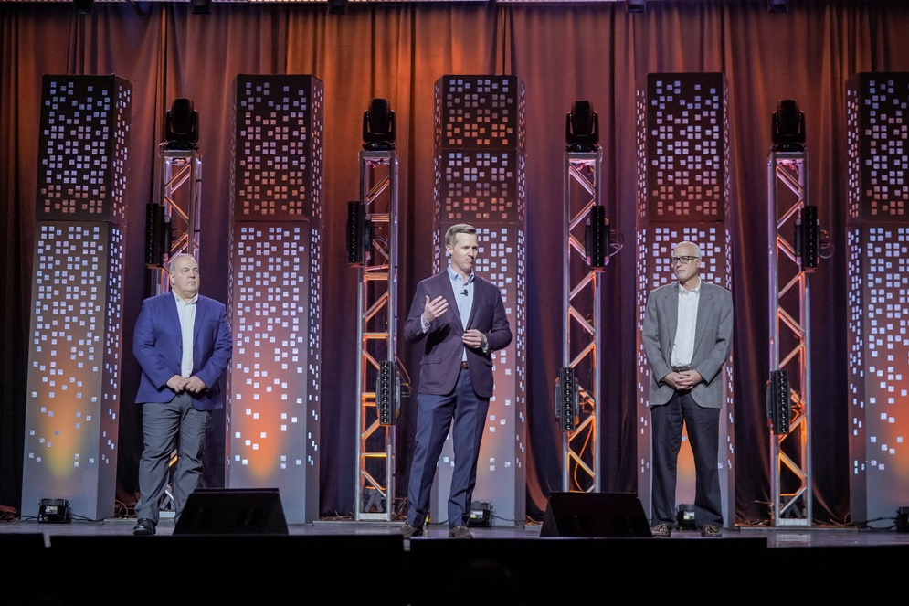
Tariff Response Plan
Ongoing Industry Wide Coordination
New ABA Online Tariff Resource Hub
Grassroots Call to Action
Ongoing Engagement with Policymakers
Notes:
As mentioned earlier, in order to maximize impact, we have to have a unified voice and that begins with coordination (as you can see in this picture from MKPL)
We are working together, joint messaging
When the Trump Administration announced tariffs on March 3rd, ABA had an online tariff resource hub that allowed our members to stay connected, educated and engage their concerns with their local member of congress
Lastly, continual engagement with policy makers

Slide 10
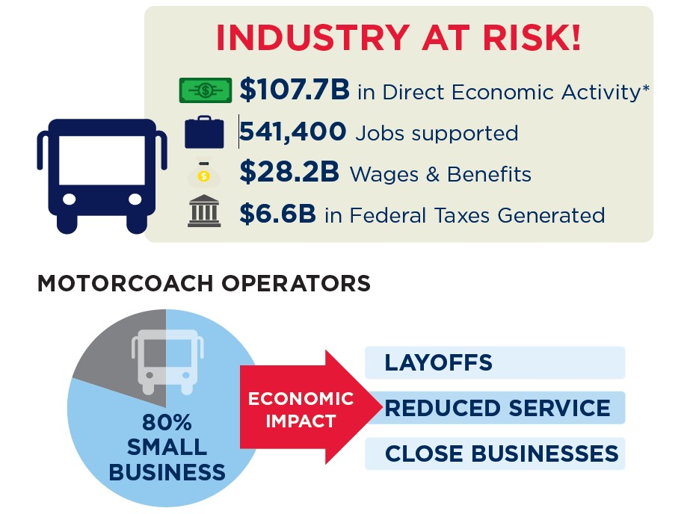
Tariffs are paused, for now
Economic Impact Study
$3.1 billion in lost business sales in 2026 and the
Elimination of 14,460 U.S. jobs.
Net loss of $34.8 million to the U.S. Treasury.
Notes:
Tariff’s are paused for now, but we still have work to do!
We have to keep working and not take our foot off the gas
As you can see in this graphic that was derived from the Foundations Economic Impact study of tariffs….

Slide 11
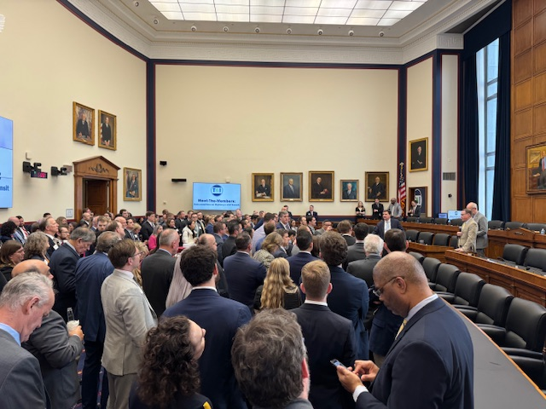
Highway Bill Reauthorization
Highway Trust Fund long-term solvency that maintains value of motorcoach fuel tax rebate
Expand and improve Intercity Bus Program 5311 (f) to provide bus transportation services for rural communities
Maintain minimum insurance liability limits
Simplify and modernize motorcoach registration and operational processes
Ensure FTA charter bus regulations compliance
Notes:
The Highway Reauthorization is the single Biggest bill that will impact our industry
Last week, Fred, Callie & myself were on Capitol Hill to meet with Members of the T&I committee and as you can see in the photo, we attended a reception with Committee members to further discuss our priorities
These 5 priorities we have for the committee (and because the font is small, im going to read them out)
What I want you to take away from this presentation is that ABA is in the middle of the fight.
Coming from Capitol Hill, that’s the only place you can be in order to land your punches

Slide 12
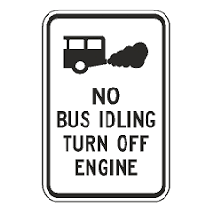
Emissions and Idling
1. Engine Idling Restrictions & Penalties
2. Public Interest Law Firms & Lawsuits
3. Environmental Benefits of Bus Transportation
4. Existing State/Local Enforcement
5. Proposed Legislative Solution
6. Recent court ruling opens the door for more
Notes:
1. Engine Idling Restrictions & Penalties
States and local governments limit bus/truck idling, with fines up to thousands of dollars.
CAA allows citizens to sue for idling violations, leading to penalties up to $121,275/day.
2. Public Interest Law Firms & Lawsuits
Groups like the Conservation Law Foundation target transportation companies for anti-idling violations.
Lawsuits aim to push intercity bus companies towards electric vehicles, despite economic and technological challenges.
3. Environmental Benefits of Bus Transportation
Buses help reduce emissions by removing cars from the road.
They have a lower emissions rate per passenger-mile compared to personal vehicles.
4. Existing State/Local Enforcement
Programs like NYC's "bounty hunter" reward individuals for reporting excessive idling.
State and local enforcement mechanisms already address idling violations.
5. Proposed Legislative Solution
ABA working to advance legislation that would protect bus operators from lawsuits over engine idling violations under state-approved plans.
Sustainability report

Slide 13
Government Funding
Opportunities and Risks
DHS Bus Security Grant Program
FTA 5311 (f) program
Funding for office of the Assistant Secretary of Commerce for Travel and Tourism
Funding for the Electronic System for Travel Authorization
Idling language
DOGE
Notes:
Programs we’re tracking:
We have a lot of balls in the air right now as an industry and ABA’s hitting the pavement to continue our advocacy
I’m here today and will be in Canada in a few weeks for the Ontario Motorcoach conference
Fred & Callie will be in NY for meetings and we’ll also be supporting the UMA fly-in, so we have a lot more work ahead but we’re putting the proper infrastructure in place to succeed no matter what punches come our way

Slide 14
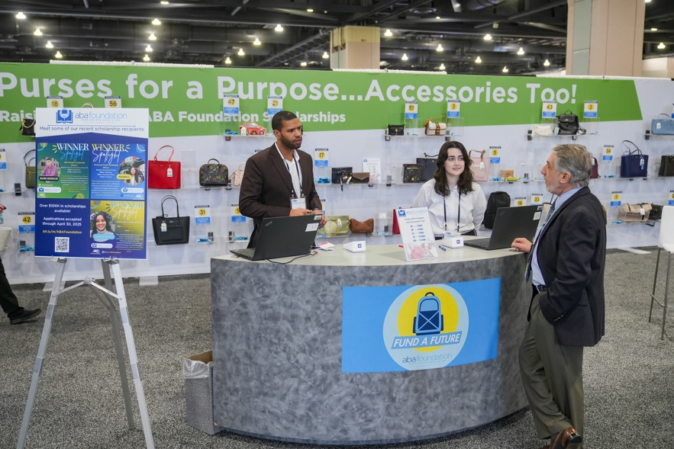
ABA Foundation
About the Foundation
The Foundation’s mission is to support the motorcoach travel and tour industry with research and scholarships that benefit the ABA, policymakers, and the public.
The ABA Foundation has awarded more than $1 million in financial support to more than 300 scholars.
Our scholarship programs help ABA members, and the public earn degrees that support the motorcoach travel and tour industry and promote academic excellence and diversity.
For more information about the ABA Foundation and its
programs, please visit www.buses.org/aba-foundation.

Slide 15
Thank you
Lmyers@buses.org

