Slide 1
Wisconsin Motor Coach Association
Milwaukee, WI · March 12, 2025
United Motorcoach Association Legislative & Regulatory Update

Slide 2
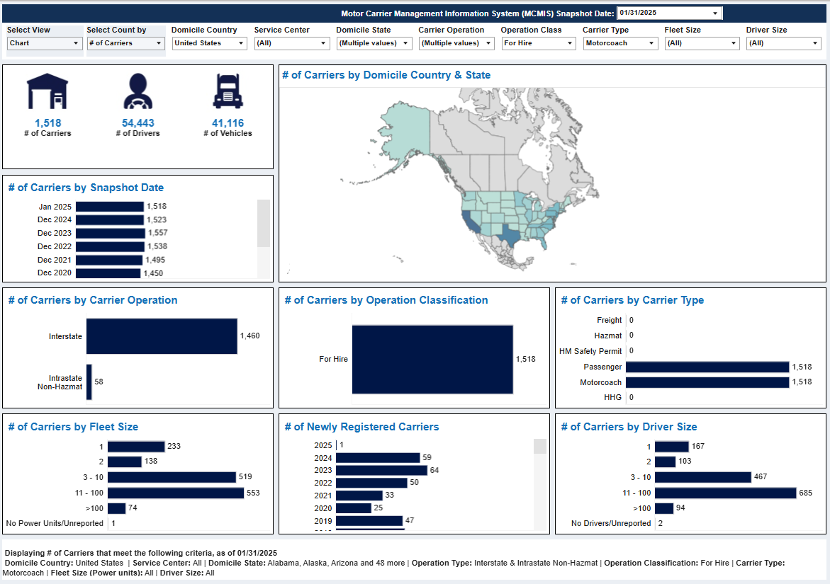
Dec 2019 - 2,976
Dec 2020 - 1,450
Dec 2021 - 1,495
Dec 2022 - 1,538
Dec 2023 - 1,557
Dec 2024 - 1,523
Jan 2025 - 1,518

Slide 3
Immediate issues -
Conclusion of FY 25 Appropriations process – March 14
Prohibition on finalization of speed limiter rule
Prohibition on NYC Congestion pricing moving forward

Slide 4
Immediate issues -
Reconciliation
House – Big Beautiful Bill
Senate – Two bills - immigration, border and energy policy,
Second for tax legislation.

Slide 5
Immediate issues -
Infrastructure Reauthorization –
Expires September 30, 2026
Insurance limits
Safety technology mandates and regulation
Clarifying over the road toll parity
Preserving charter bus protections

Slide 7
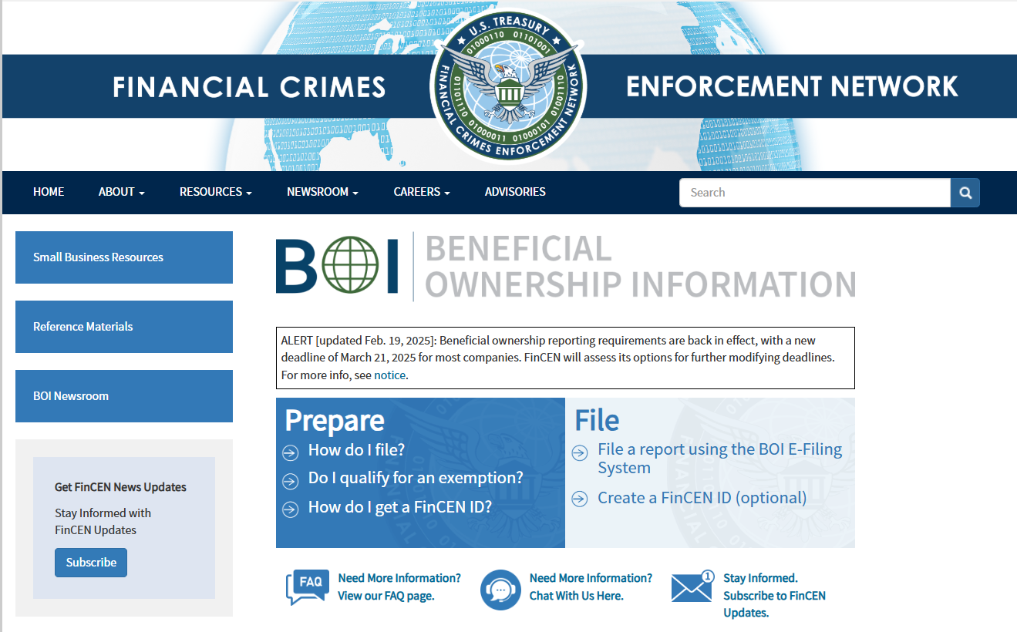

Slide 8
U.S. Department of Labor
Small Vehicle Exemption
The employee’s work, in whole or in part, is that of a driver, driver's helper, loader or mechanic affecting the safety of operation of motor vehicles weighing 10,000 pounds or less in transportation on public highways in interstate or foreign commerce, except vehicles:
(a) Designed or used to transport more than 8 passengers, including the driver, for compensation; or
(b) Designed or used to transport more than 15 passengers, including the driver, not used to transport passengers for compensation; or
(c) Used in transporting hazardous material, requiring placarding under regulations prescribed by the Secretary of Transportation; and
2. The employee performs duties on motor vehicles weighing 10,000 pounds or less.
The Section 13(b)(1) exemption does not apply to an employee in such work weeks even though the employee's duties may also affect the safety of operation of motor vehicles weighing greater than 10,000 pounds, or other vehicles listed in subsections (a), (b) and (c) above, in the same work week.

Slide 9
Tolling:
Equal Access for Over-the-Road Buses
https://www.fhwa.dot.gov/ipd/tolling_and_pricing/tolling_pricing/active_agreements.aspx

Slide 10
Pending…
Experimental Study: Study of Warning Devices for Stopped Commercial Motor Vehicles
Drivers may now appeal not-at-fault crashes
Safety Fitness Determination Proposed Rule
Speed Limiter Rule/National Speed Limit - May 2024 release MAY 2025
Appeal Process for Requests for Data Review
California Meal and Rest Breaks

Slide 11
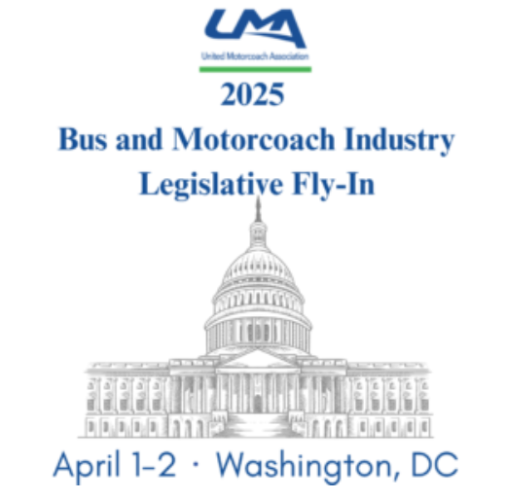

Slide 12
Immediate issues -
Tariffs
Three tranches by executive order:
China;
Canada and Mexico;
EU and rest of the world

Slide 13
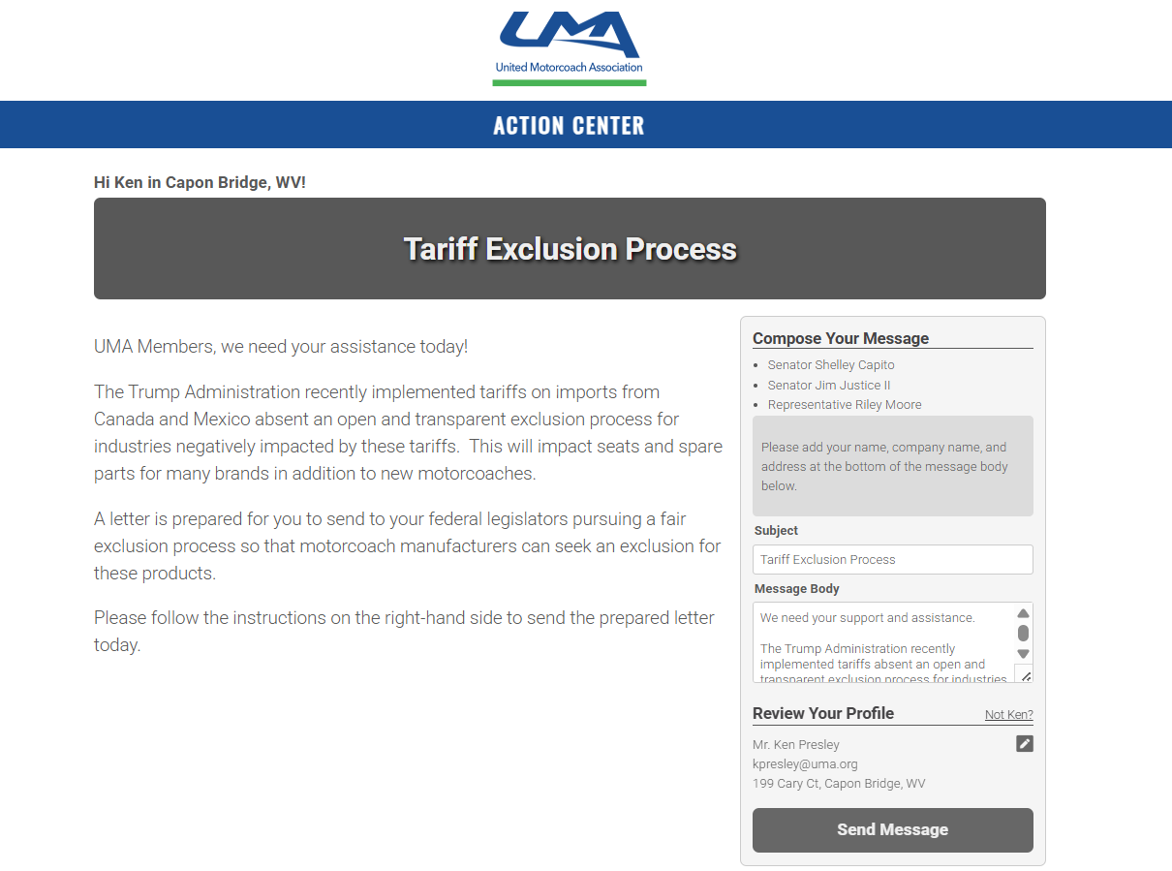
CLICK HERE

Slide 14
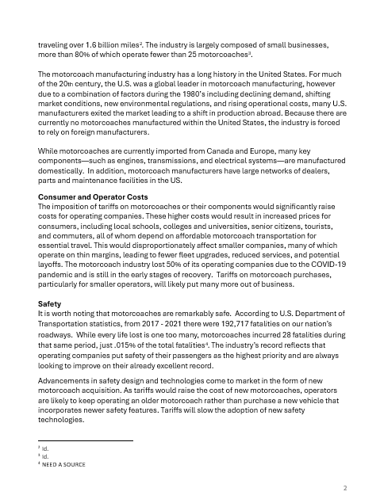
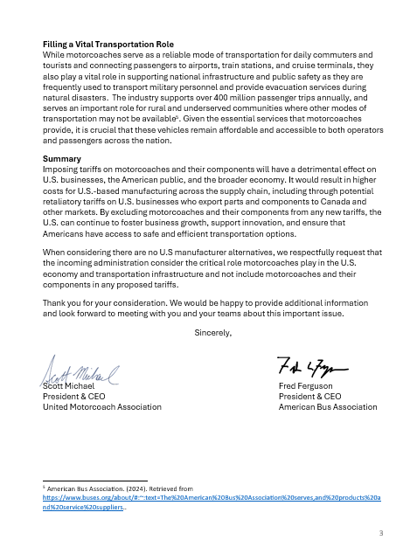
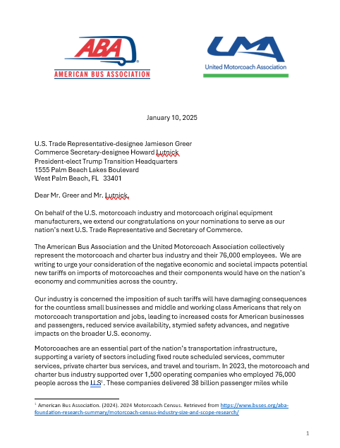

Slide 15
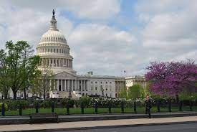
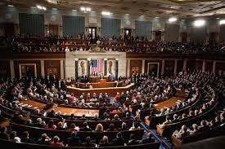
Tariffs
Increased Financial Responsibility
Charter Service Rule
Fuel Tax Exemption
Heavy Vehicle Tax
Toll Parity / NYC Congestion Pricing
Speed Limiter Requirement
Small Fleet Fuel Purchase Program
Illegal Migrant Transportation
Pretrip/Seatbelt
EPA/CARB

