Slide 2
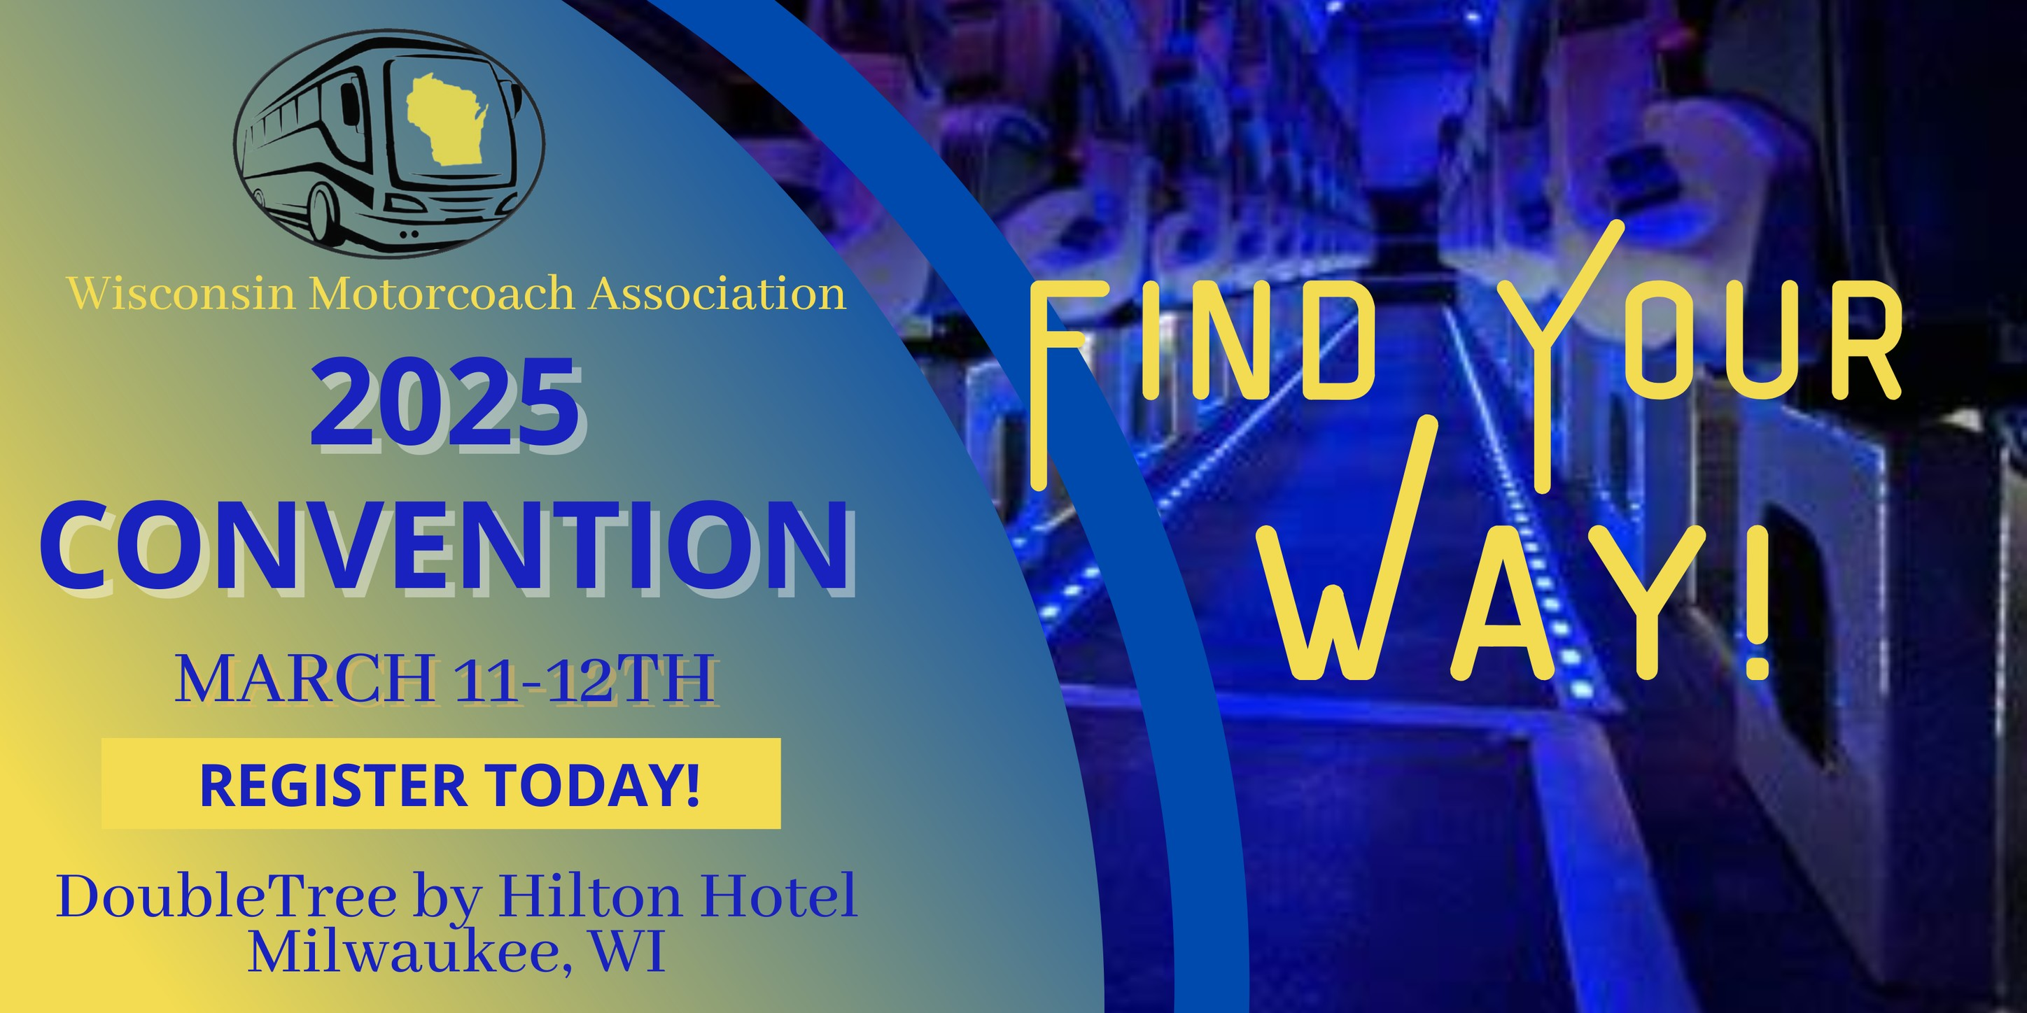
TODAY’S DISCUSSION
The Power of Storytelling
The Key Elements of a Great Travel Story
Finding & Crafting Your Brand's Story
Bringing Stories to Life Across Marketing Channels
Interactive Workshop: Craft Your Own Story
Wrap-Up & Actionable Takeaways
Audience Engagement Elements
Notes:
“Thank you for being here today! Travel marketing is all about inspiration. People don’t book a trip because of logic—they book because of emotion. And what’s the best way to create that emotion? Through storytelling. Today, we’re going to explore how you can turn your marketing into a powerful storytelling tool that captivates, connects, and converts your audience into customers.”

Slide 3
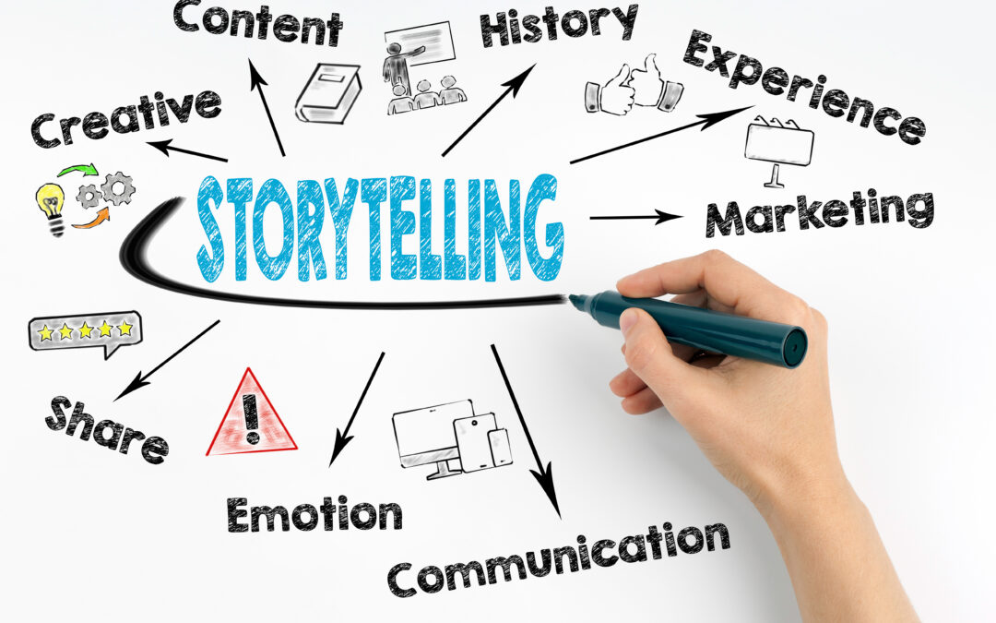
The Power of Storytelling
Let’s Start With A Question……What makes you book a trip?
The emotional and psychological impact of storytelling on consumer behavior.
Case studies of brands that have successfully used storytelling to increase engagement and bookings.
Notes:
“Let’s start with a question—how many of you have ever booked a trip because of a story someone told you? Maybe a friend raved about a great destination, or you saw a compelling video on social media. Stories are what drive decisions. People remember experiences, emotions, and the feeling of ‘I want to be there.’ Our job as travel marketers is to craft those stories that inspire action.”

Slide 4
The Power of Storytelling
Many businesses struggle with storytelling because they don’t know where to start. Here’s the secret: your customers are already telling your best stories. You just need to capture them. Testimonials, social media posts, and real experiences—these are your goldmine. What’s a great story from one of your customers? How did their trip impact them? These are the stories that create trust and excitement.
Notes:
“Let’s start with a question—how many of you have ever booked a trip because of a story someone told you? Maybe a friend raved about a great destination, or you saw a compelling video on social media. Stories are what drive decisions. People remember experiences, emotions, and the feeling of ‘I want to be there.’ Our job as travel marketers is to craft those stories that inspire action.”

Slide 5
The Power of Storytelling
Airbnb – “Live There” Campaign of brands that have successfully used storytelling to increase engagement and bookings.
Storytelling Approach: Instead of promoting just accommodations, Airbnb focused on travelers experiencing destinations like a local. Their "Live There" campaign showcased real stories of hosts and guests, making the experience personal and aspirational.
Result: Increased bookings and positioned Airbnb as more than just a place to stay—it became a gateway to authentic experiences.
Notes:
“Let’s start with a question—how many of you have ever booked a trip because of a story someone told you? Maybe a friend raved about a great destination, or you saw a compelling video on social media. Stories are what drive decisions. People remember experiences, emotions, and the feeling of ‘I want to be there.’ Our job as travel marketers is to craft those stories that inspire action.”

Slide 6
The Power of Storytelling
Nike – “Find Your Greatness”
Storytelling Approach: Nike’s marketing isn’t about selling shoes; it’s about inspiring people to push beyond their limits. Their “Find Your Greatness” campaign told real stories of everyday athletes overcoming challenges, showing that greatness is within everyone’s reach.
Result: Strengthened brand loyalty and emotional connection, driving global sales.
Notes:
“Let’s start with a question—how many of you have ever booked a trip because of a story someone told you? Maybe a friend raved about a great destination, or you saw a compelling video on social media. Stories are what drive decisions. People remember experiences, emotions, and the feeling of ‘I want to be there.’ Our job as travel marketers is to craft those stories that inspire action.”

Slide 7
The Power of Storytelling
Nike – “Find Your Greatness”
Storytelling Approach: Nike’s marketing isn’t about selling shoes; it’s about inspiring people to push beyond their limits. Their “Find Your Greatness” campaign told real stories of everyday athletes overcoming challenges, showing that greatness is within everyone’s reach.
Result: Strengthened brand loyalty and emotional connection, driving global sales.
Notes:
“Let’s start with a question—how many of you have ever booked a trip because of a story someone told you? Maybe a friend raved about a great destination, or you saw a compelling video on social media. Stories are what drive decisions. People remember experiences, emotions, and the feeling of ‘I want to be there.’ Our job as travel marketers is to craft those stories that inspire action.”

Slide 8
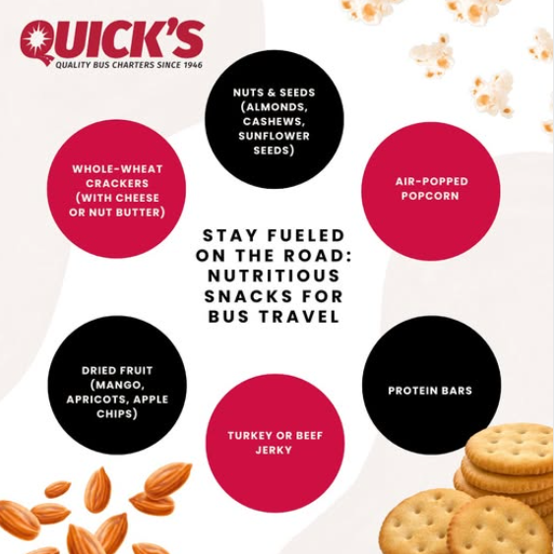
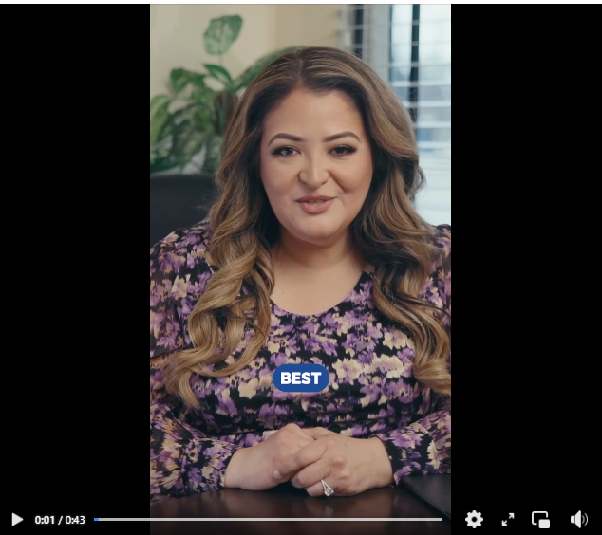
The Key Elements of a Great Travel Story
The Hero’s Journey: Positioning the traveler as the hero, with your business as the guide.
Emotion-Driven Content: How to create stories that resonate with group travelers.
Authenticity Matters: Using real testimonials, experiences, and behind-the-scenes moments.
The Power Of Visuals: How to enhance stories with compelling imagery and video.
Notes:
“Studies show that people make decisions based on emotions first, then justify them with logic. A good story releases dopamine, making people feel connected and engaged. When your marketing is just about logistics—dates, prices, and schedules—it’s forgettable. But when you tell a compelling story, your audience is hooked.”

Slide 9
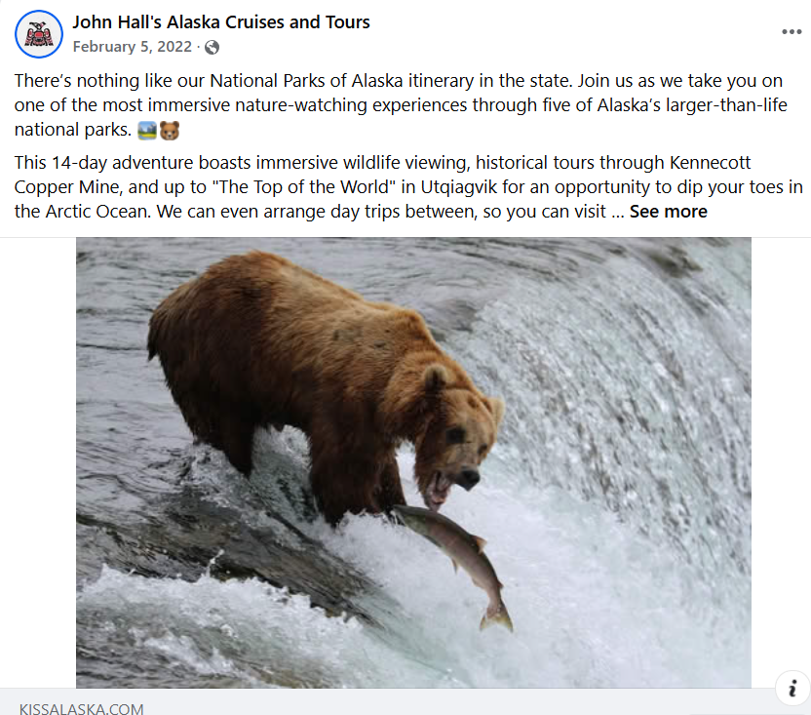
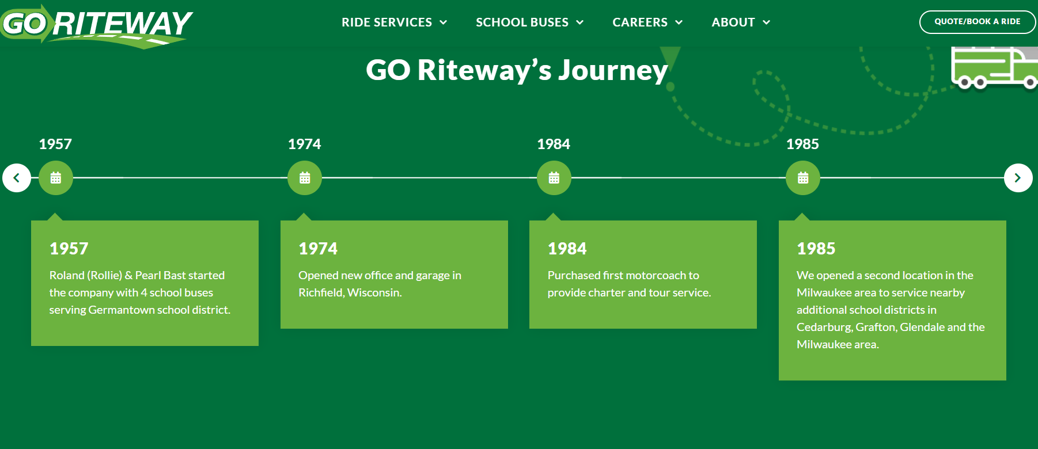
The Key Elements of a Great Travel Story
Notes:
“Studies show that people make decisions based on emotions first, then justify them with logic. A good story releases dopamine, making people feel connected and engaged. When your marketing is just about logistics—dates, prices, and schedules—it’s forgettable. But when you tell a compelling story, your audience is hooked.”

Slide 10
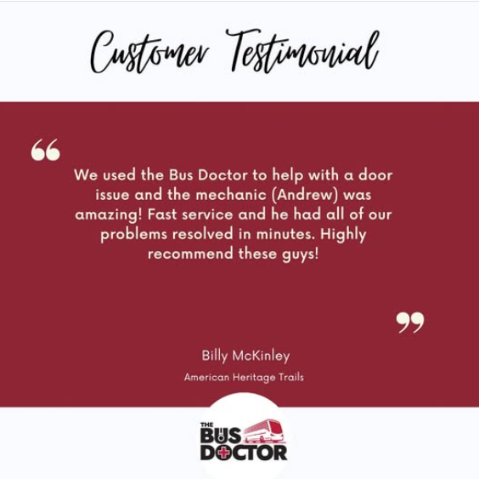
Finding & Crafting Your Brand's Story
Identifying your unique brand narrative.
Techniques for collecting and structuring impactful stories.
Turning customer experiences and testimonials into engaging narratives.
Notes:
“There are a few key elements to every great travel story:
A hero (your customer)
A journey (their experience)
A guide (your business)
A transformation (the impact of their trip)”* “Every travel experience is a story waiting to be told. Your customers don’t just take a trip—they embark on an adventure that changes them. Your job is to showcase that transformation.”

Slide 11
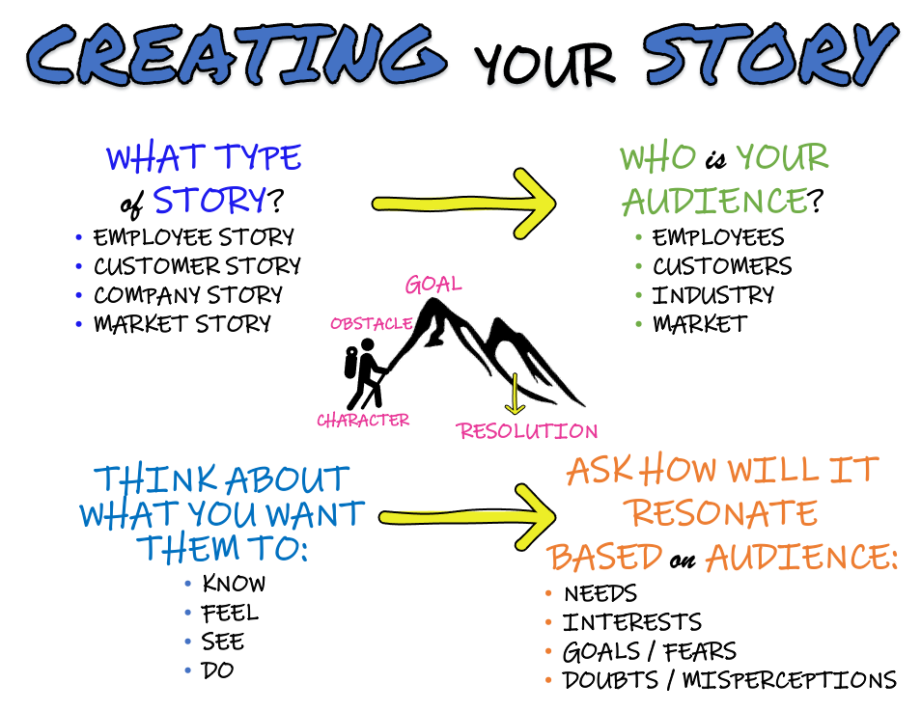
Interactive Workshop: Craft Your Own Story
Why storytelling is essential in travel marketing.
The emotional and psychological impact of storytelling on consumer behavior.
Case studies of brands that have successfully used storytelling to increase engagement and bookings.
Notes:
Many businesses struggle with storytelling because they don’t know where to start. Here’s the secret: your customers are already telling your best stories. You just need to capture them. Testimonials, social media posts, and real experiences—these are your goldmine. What’s a great story from one of your customers? How did their trip impact them? These are the stories that create trust and excitement.”

Slide 12
Wrap-Up & Actionable Takeaways
How Motorcoach Companies Can Use Storytelling to Increase Awareness & Sales
✅ Feature Passenger Stories – Ask satisfied customers to share their experiences on your tours. Post these on social media, your website, or in email newsletters.
✅ Create Short Videos – Capture scenic views, happy travelers, or testimonials while on the road. Use these clips for marketing on Instagram, Facebook, and YouTube.
✅ Highlight First-Time Travelers – Encourage those new to bus travel to share their experiences and how group travel surprised them.

Slide 13
Wrap-Up & Actionable Takeaways
✅ Run a “Share Your Journey” Campaign – Have passengers tag your business in their travel posts to create user-generated content (UGC).
✅ Tell the Story of Your Company & Team – Share how your company was founded, why you love group travel, and what makes your team passionate about hospitality.
✅ Make Sustainability a Story – If your motorcoaches are fuel-efficient or support green initiatives, turn that into a compelling sustainability message.

